Slide 1
Green University of Bangladesh
Department of Computer Science & Engineering
Subject: Electrical Drives and Instrumentation
Course Code: EEE-205
My Presentation topic : Transformer
Submitted To:
Name : Ms. Shahela Akter
Designation : Lecturer
Department : EEE
Green university of Bangladesh
Submitted by:
Name : Jakirul Islam
ID :193002101
Section :DB (193)
Department : CSE

Slide 2
Contents
Introduction
Types
Working
Applications
Conclusion

Slide 3
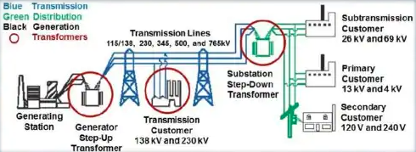
Introduction
It is a device that changes AC electrical power at one voltage level into AC electrical power at another voltage level through the action of magnetic field, without a change in frequency.

Slide 4
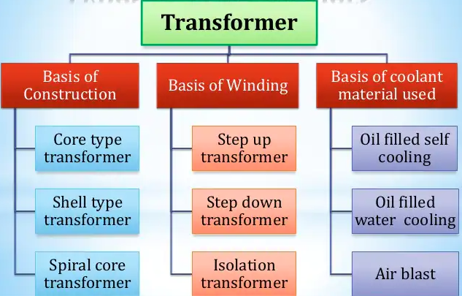
Types of Transformer

Slide 5
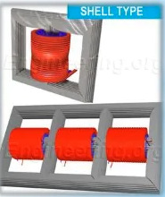
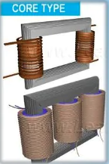
Basis of construction
Shell type transformer:
Its core has three limbs and two windows. Both the windings are wounded on the central limb.
Core Type transformer:
Its core has two limbs .The windings are wounded on two limbs of the core material.

Slide 6
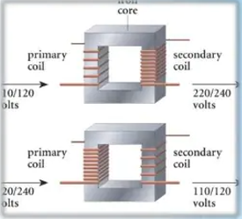
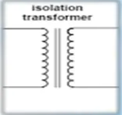
Basis of Windings
Step-up transformer:
Step-down transformer:
Isolation Transformer:

Slide 7
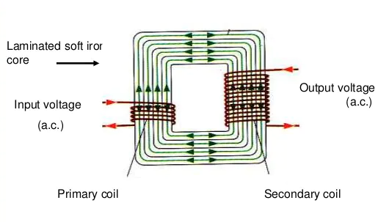
Transformer Works

Slide 8
Applications
Transmitting electrical energy over long distances through wires.
They couple signals between electronic stages.
They much loads with internal resistance so that there is maximum power transfer.
It can isolate two circuits electrically.
Used as voltage regulator
It can be used to prevent DC from passing from one circuit to the another.

Slide 9
Conclusion
The method could possibly used for the transfer of electricity across the country via the power lines. the circuit was not supplying the most efficient or maximum efficiency, due to the core losses not equaling the copper losses.
So if you increases the voltage out, then the current out must decreases. If you step up the voltage , so that voltage output is double the voltage input.

Slide 10
Thank You

